Slide 1
Unit 7: Sorting BY : S. R. Sharma
Preliminaries of sorting, bubble sort, insertion sort
lower bound for simple sorting algorithm
Shell sort, heap sort, merge sort, quick sort,
Bucket sort,
Notes:
We designed this template so that each member of the project team has a set of slides with its own theme. Members, here’s how you add a new slide to just your set:
Mark where you want to add the slide: Select an existing one in the Thumbnails pane, click the New Slide button, then choose a layout. The new slide gets the same theme as the other slides in your set.
Careful! Don’t annoy your fellow presenters by accidentally changing their themes. That can happen if you choose a different theme from the Design tab, which changes all of the slides in the presentation to that look.

Slide 2
Preliminaries of sorting
The algorithm we describes will be interchangeable.
Each will be passed an array containing the elements and an integer containing the number of elements.
We will assume that existence of the “<“ and ”>” operators for the comparisons.
Sorting under these condition is known as comparisons-based sorting.

Slide 3
Insertion sort
The insertion sort insert each elements in proper place. If there are N elements in the array and we place each element of array at proper place in previously sorted element list.
let us take there are N elements in the arr. The process of inserting each elements in proper place is as;
Pass1: arr[0] is already sorted because only one element.
Pass 2: arr[1] is inserted before or after arr[0].
so that arr[0] and arr[1] are sorted.

Slide 4
Cont……
Pass 3: arr[2] is inserted before arr[0], in between arr[0] and arr[1], or after arr[1].
so that arr[0],arr[1] and arr[2] are sorted
………………………………………………………………
………………………………………………………………..
Pass N-1: arr[N-1] is inserted into its proper place in array arr[0] ,arr[1], arr[2] ………..arr[N-2]
So arr[0],arr[1], arr[2] ……..arr[N-1] are sorted.

Slide 5
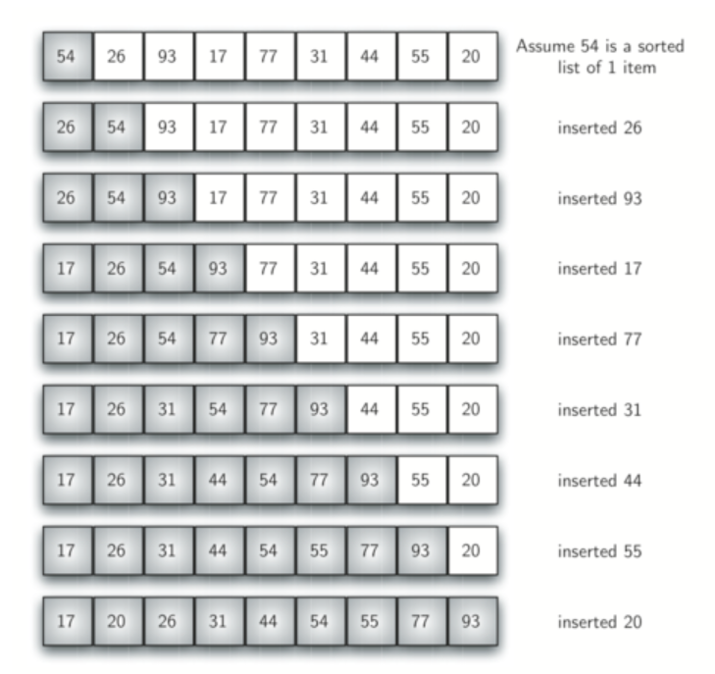

Slide 6
Analysis of insertion sort
The first elements has no other elements before it. So it does not required any comparison . Second element requires 1 comparison ,third requires 2 comparisons and so on . Therefore total number of comparisons will be:-
1+2+3……………+(N-2)+(N-1)
it’s a form of arithmetic progression so we can apply formula :

Slide 7
Cont..
Sum = N/2[2a+(n-1)d]
=(n-1)/2[2*1+(n-1-1)*1]
=(n-1)/2[2+n-2]
= n(n-1)/2 which is of o(n²).
it’s worse case of behaviour of insertion sort where all elements are in reverse order.
Insertion sort behaves as of o(n) when elements are in sorted order and also has worth when list of elements are near about sorted.

Slide 8
Bubble sort
If N elements are given in memory then for sorting, we will do following steps:-
1. first compare first and second element of array if 1st <2nd then
compare the 2nd with 3rd
2. if 2nd > 3rd then interchange the value of 2nd and 3rd
3. now we compare the value of 3rd with 4th
4. similarly compare until the N-1 th element is compared with N th
element
5. now the highest value element is reached at the Nth place.
6. now elements will be compared until N-1 elements

Slide 9
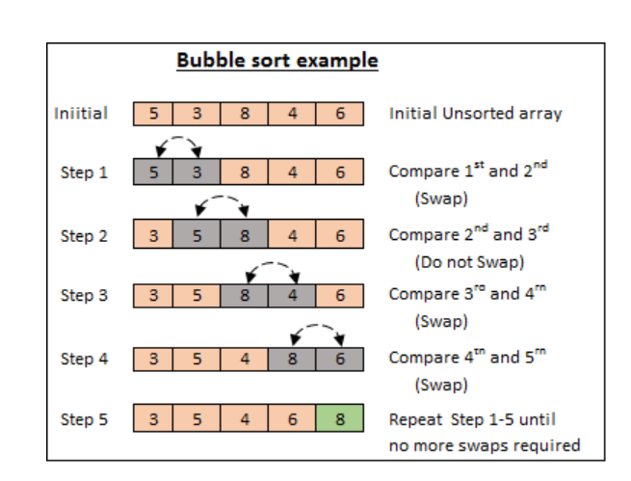

Slide 10
Analysis of bubble sort.
In bubble sort n-1 )comparison will be in 1st pass, n-2 in 2nd pass,n-3 in 3rd pass and so on.it is very simple to calculate the number of comparison. Total number of comparison wiil be
(n-1)+(n-2)+(n-3)+…….+3+2+1. it’s a form of arithmetic progession , so we can apply formula
Sum=n/2[2a+(n-1)d] => (n-1)/2[2*1(n-1-1)*1]
=(n-1)/2[2+n-2]
=n(n-1)/2 which is of O(n²).

Slide 11
Cont..
The main advantages of bubble sort is simplicity of algorithm, additional space requirement is only one temporary variable and it behaves as 0(n) for sorted array of element.

Slide 12
Selection sort
The process of sorting elements using selection sort is as
Pass 1: a. searach the smallest elements from arr[0] ……arr[n-1].
b. interchange arr[0] with the smallest element.
Result: arr[0] is sorted
Pass 2: a. searach the smallest elements from arr[1] ……arr[n-1]
b. interchange arr[1] with the smallest elements
Result : arr[0], arr[1] is sorted.
Pass N-1: a. search smallest elements from arr[n-2] and arr[n-1]
b. interchange arr(n-2) with smallest
Result : arr[0] ……………arr[n-1] is sorted.

Slide 13
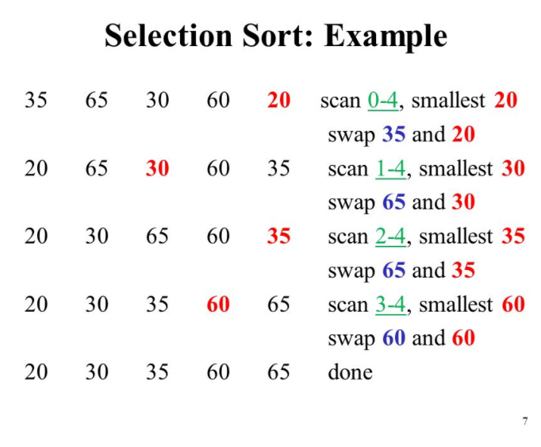

Slide 14
Analysis of selection sort
In selection sort pass one will compare n-1 elements pass 2 will compare n-2 elements and so on pass n-2 will compare only 1 elements so , total number of elements comparison is given by
sum=(n-1)+(n-2)+(n-3)+…………..3+2+1
it is arithmetic series in decreasing oreder so apply formula
Sum = n/2[2a+(n-1)d]
= (n-1)/2[2(n-1)+{(n-1)-1}{(n-2)-(n-1)}]
=(n-1)/2[2n-2+(n-1-1)(n-2-n+1)]
=(n-1)/2[2n-2-n+2)
=n(n-1)/2
=0(n²) its has same behavior in both worst case and best case.

